Slide 1
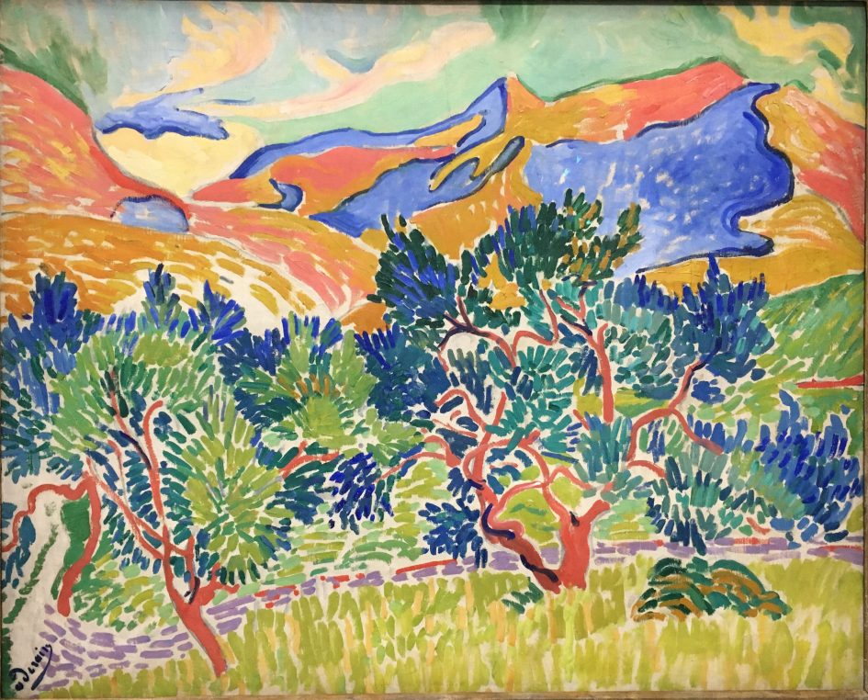
FAUVISM
Avant-Garde Movement
History of Modern Art
BFA-III (Visual Arts)
Course Incharge: Ms. Sidra Liaqat
Institute of Design & Visual Arts, LCWU

Slide 2
Henri Matisse
(1869 – 1954)
France

Slide 3
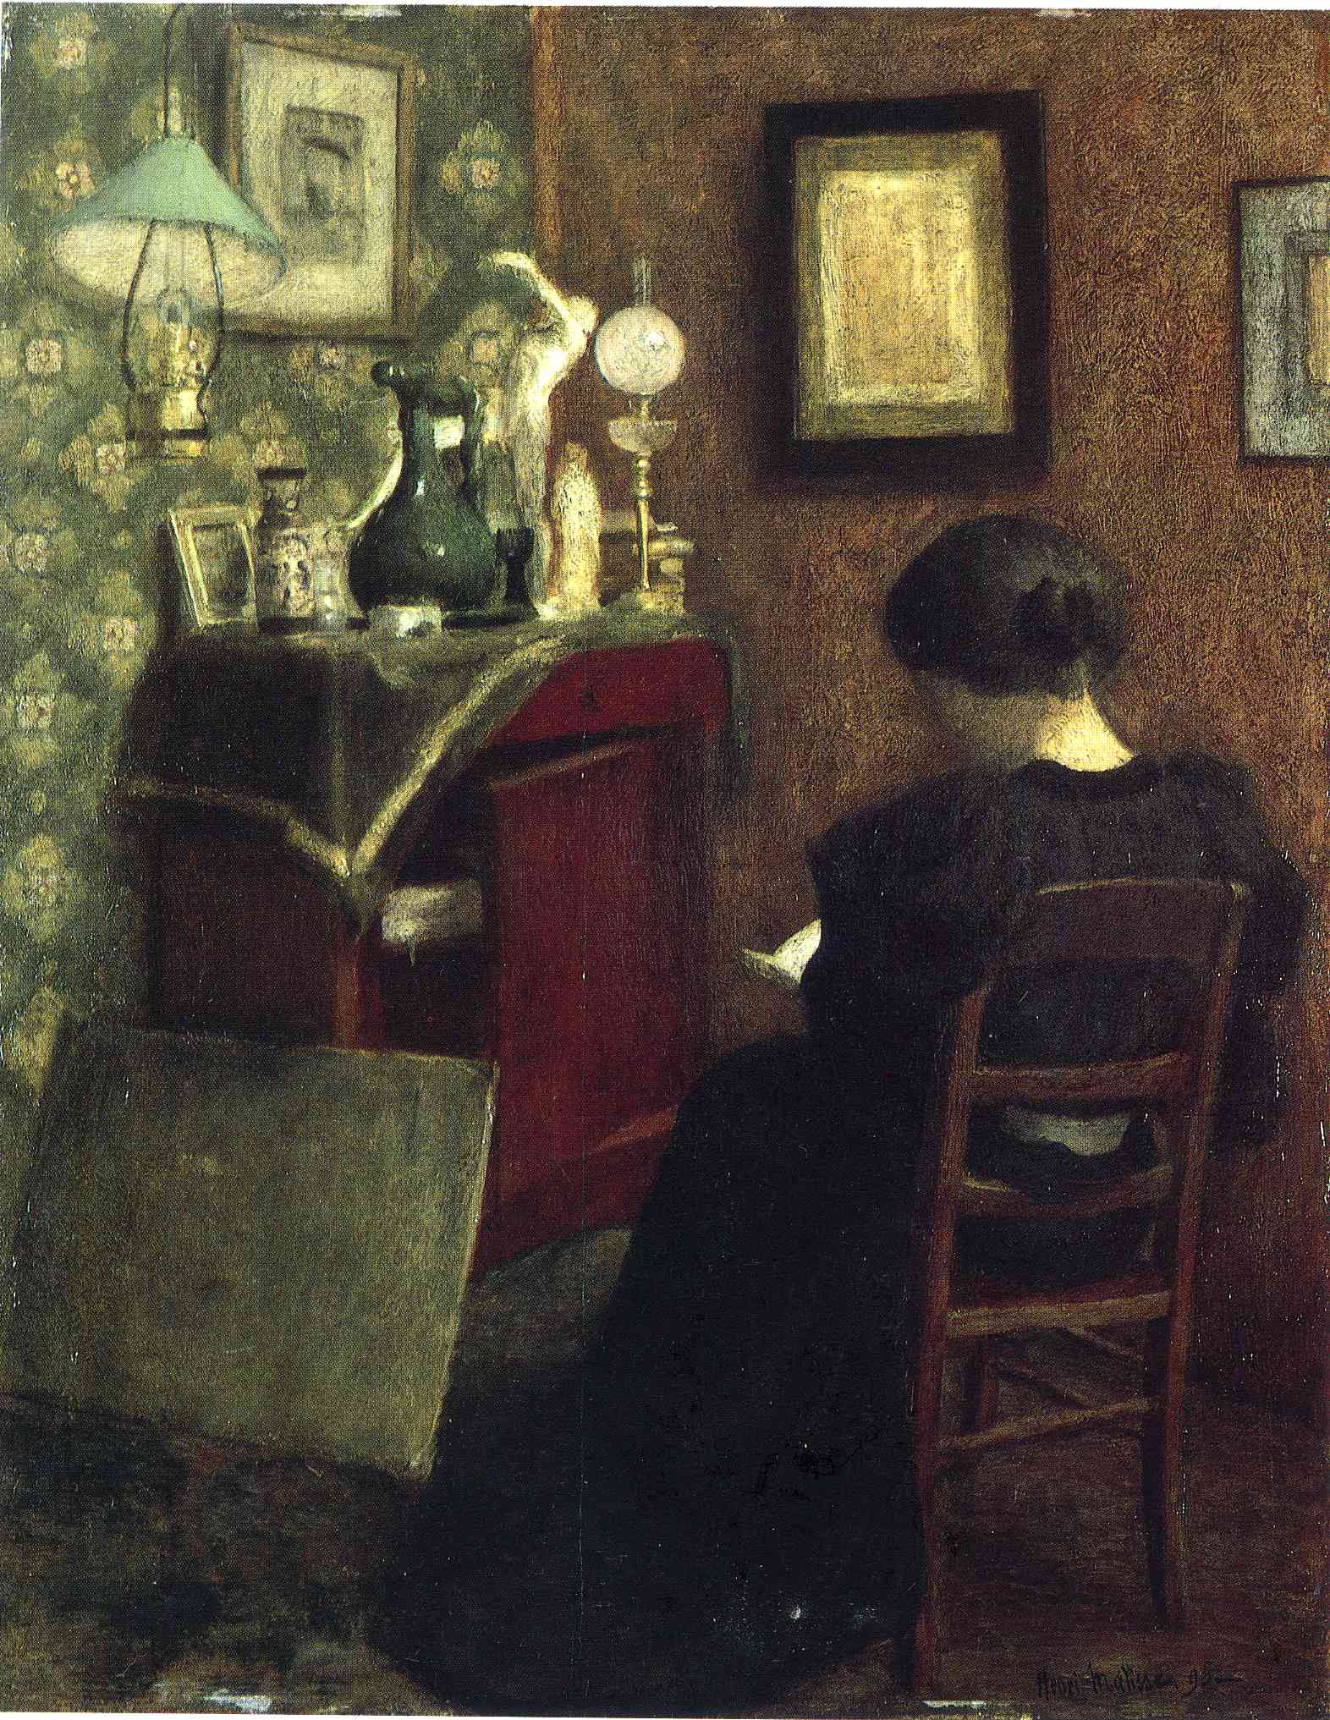
“Woman Reading”
(1896)

Slide 4
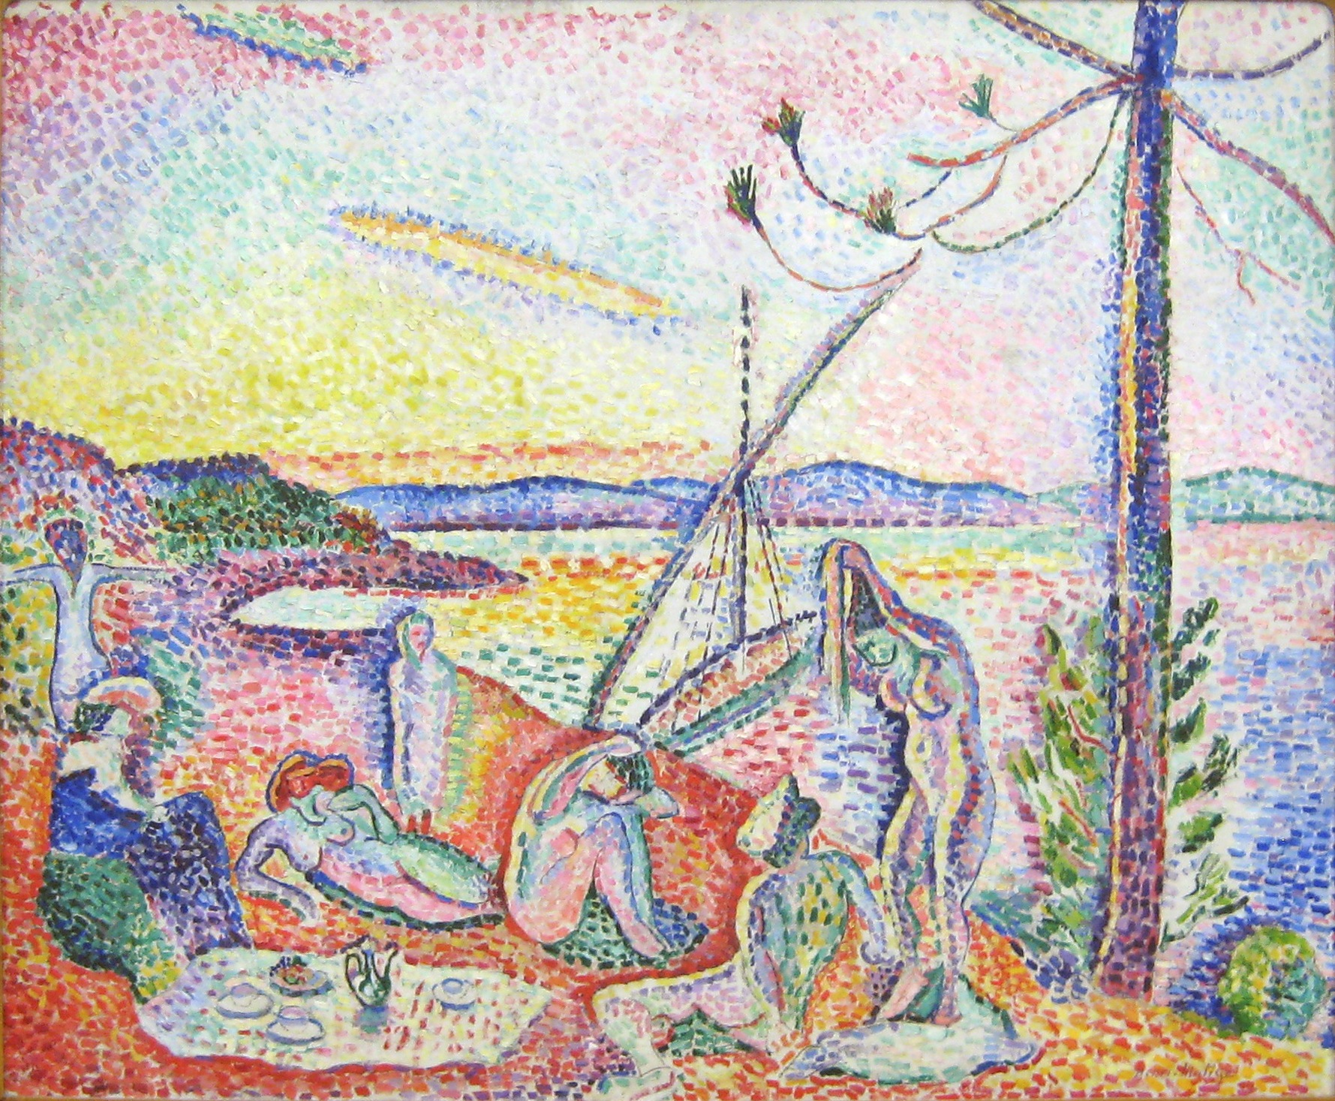
“Luxe, Calme et Volupté”
(1904)

Slide 5
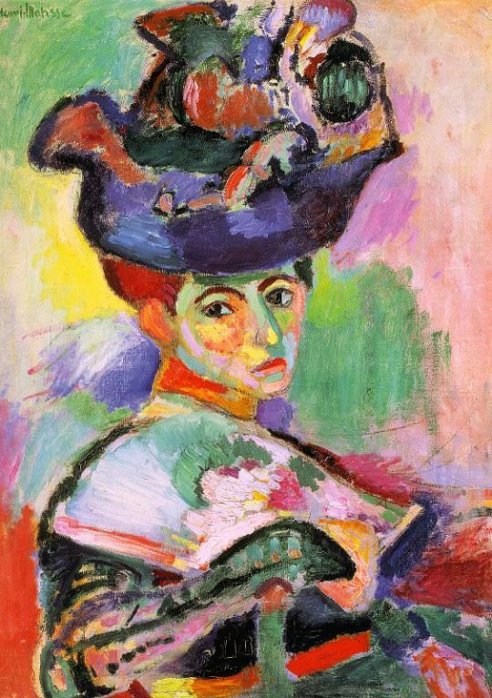
He explained his approach: “What characterized fauvism was that we rejected imitative colors, and that with pure color we obtain stronger reactions – more striking simultaneous reactions, and there was also the luminosity of our colors.”
“Woman with the Hat”
(1905)

Slide 6
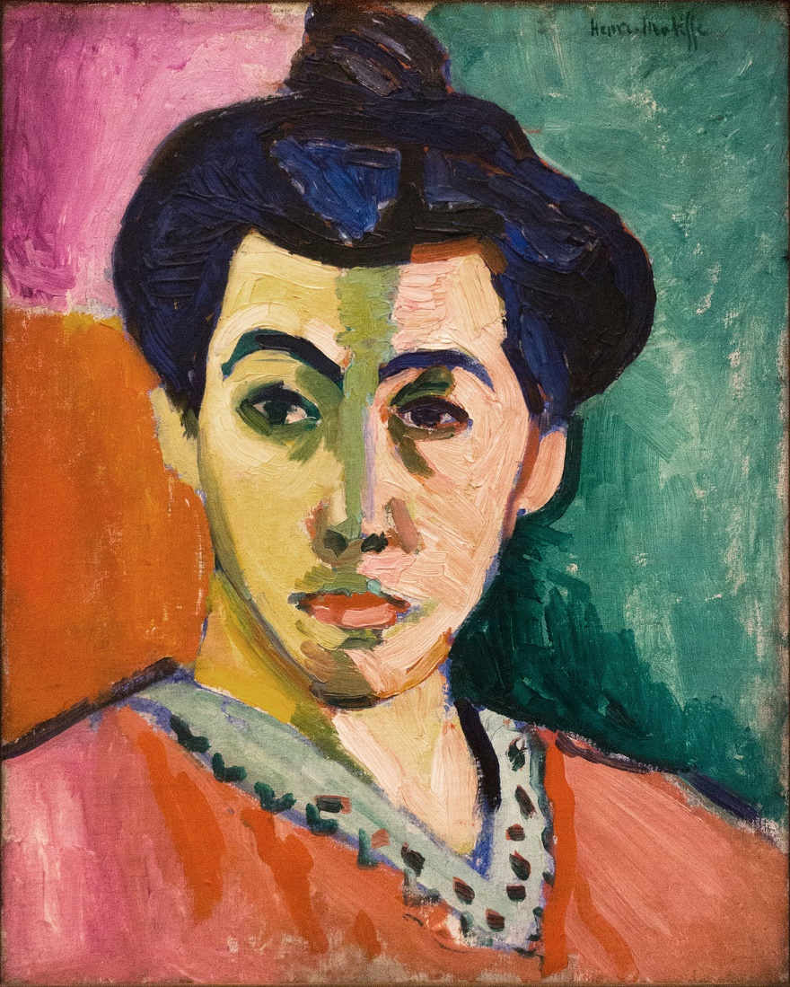
“Portrait with the Green Stripe”
(1905)

Slide 7
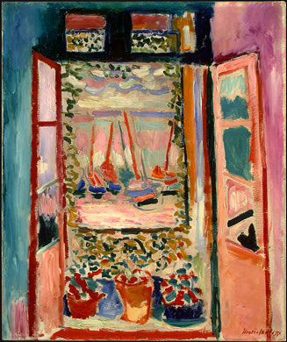
“The Open Window”
(1905)

Slide 8
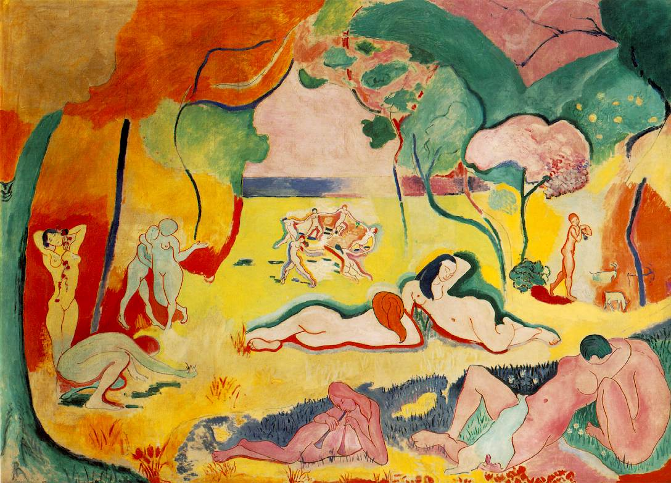
“The Joy of Life”
(1906)

Slide 9
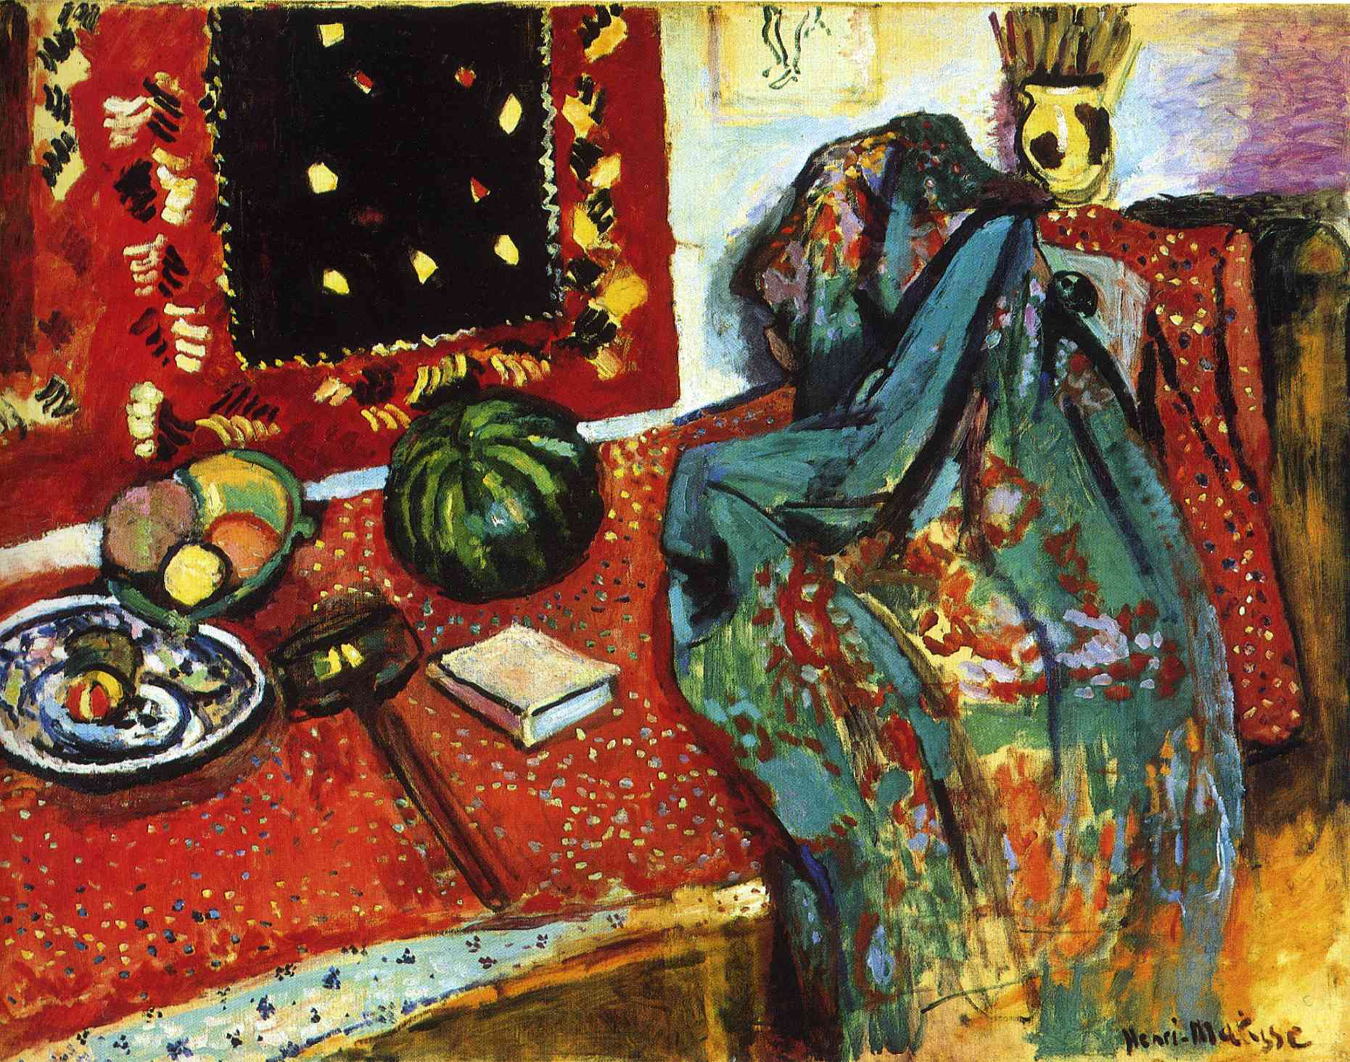
“Still Life with a Red Carpet”
(1906)

Slide 10
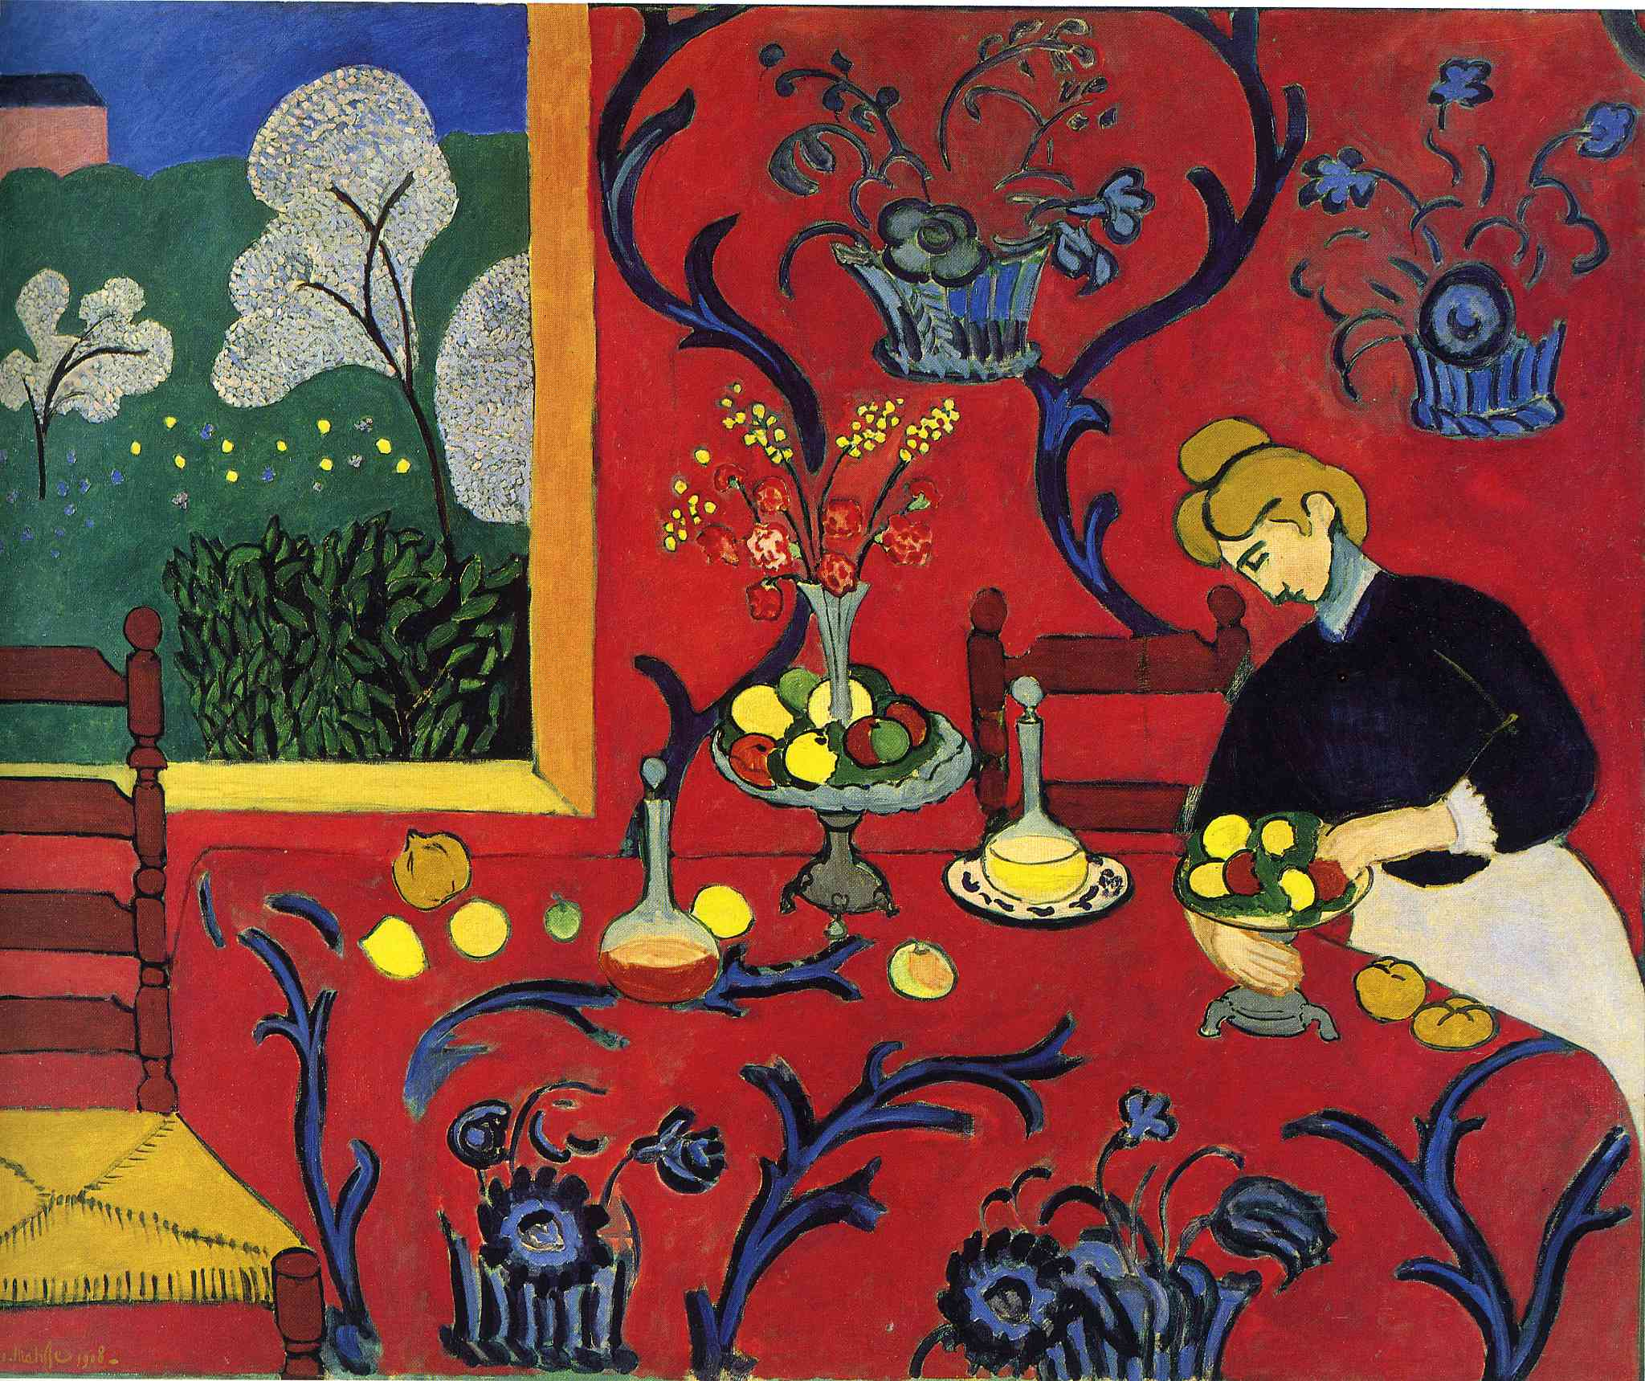
Henri Matisse writes, “Composition is the art of arranging in a decorative manner the diverse elements at the painter’s command to express his feelings.”
“I cannot copy nature in a servile way; I am forced to interpret nature and submit it to the spirit of the picture.”
“Harmony in Red”
(1909)

Slide 11
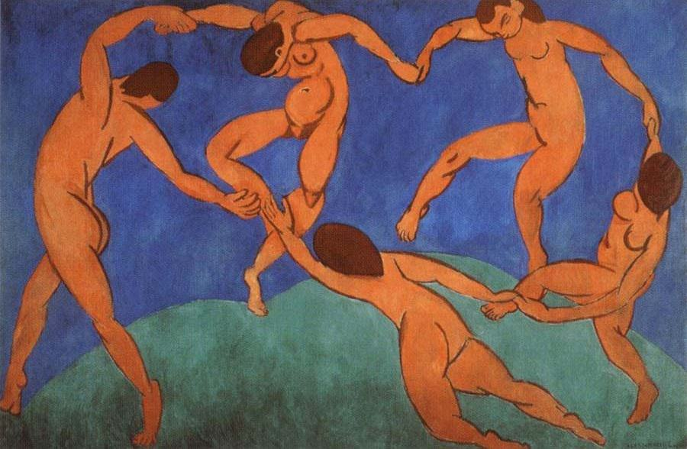
“The Dance”
(1910)

Slide 12
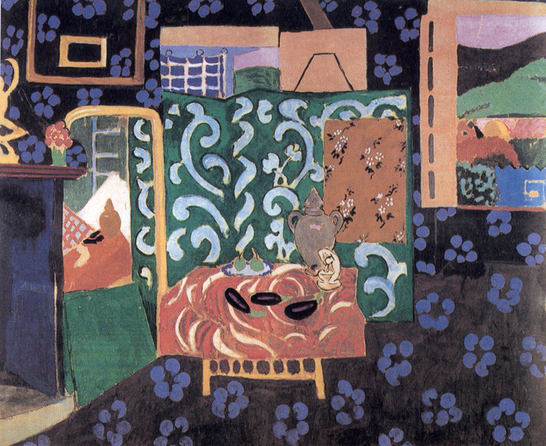
“Interior with Aubergines / Eggplants”
(1911)

Slide 13
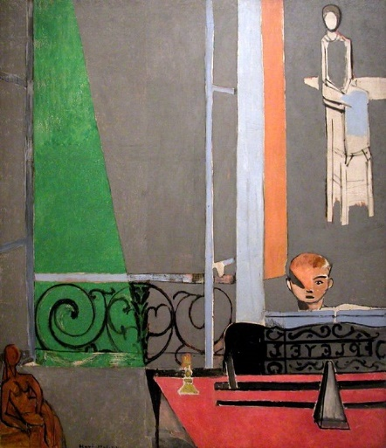
“Piano Lesson”
(1916)

Slide 14
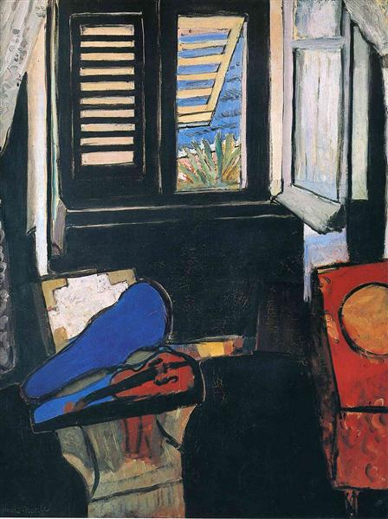
“Interior with a Violin”
(1918)

Slide 15
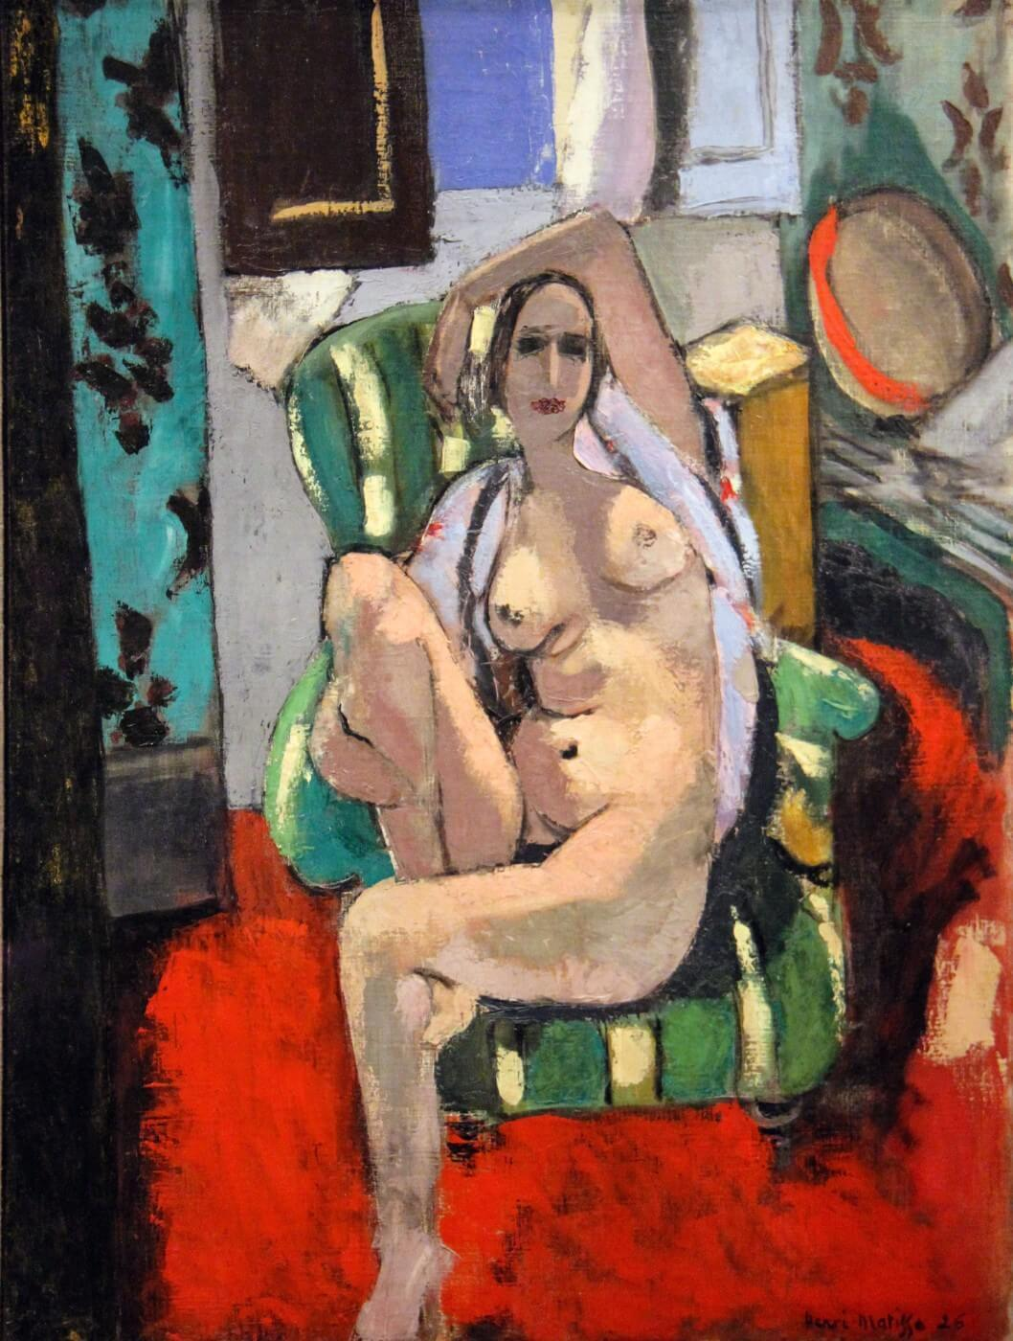
“Odalisque with a Tambourine”
(1926)

